Slide 1
Linear Algebra

Slide 2
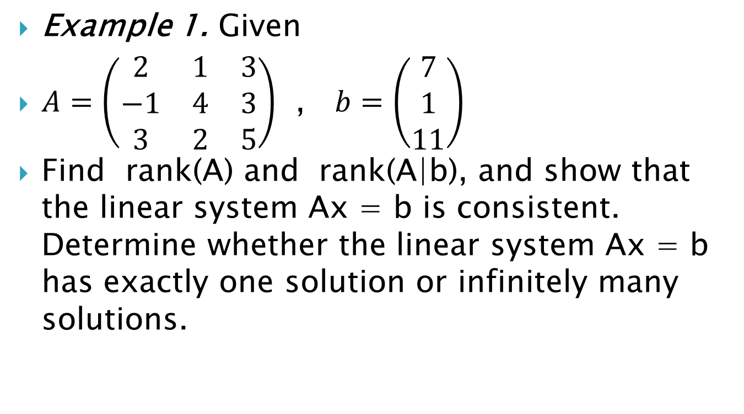
Example 1. Given
$A=\left(\begin{matrix}2 & 1 & 3 \\ −1 & 4 & 3 \\ 3 & 2 & 5\end{matrix}\right)$ , $b=\left(\begin{matrix}7 \\ 1 \\ 11\end{matrix}\right)$
Find rank(A) and rank(A|b), and show that the linear system Ax = b is consistent. Determine whether the linear system Ax = b has exactly one solution or infinitely many solutions.

Slide 3
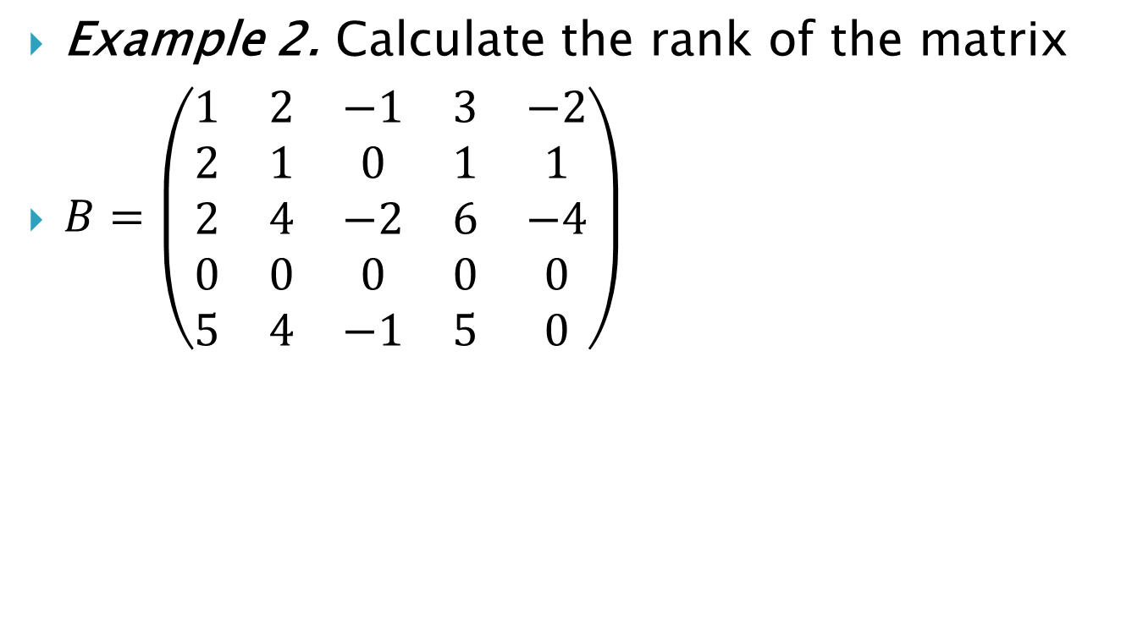
Example 2. Calculate the rank of the matrix
$B=\left(\begin{matrix}1 & 2 & −1 & 3 & −2 \\ 2 & 1 & 0 & 1 & 1 \\ 2 & 4 & −2 & 6 & −4 \\ 0 & 0 & 0 & 0 & 0 \\ 5 & 4 & −1 & 5 & 0\end{matrix}\right)$

Slide 4

Example 3. Calculate the rank of the matrix
$C=\left(\begin{matrix}2 & 3 & 1 & 6 \\ −1 & −2 & 0 & −3 \\ 3 & 5 & 1 & 9\end{matrix}\right)$

Slide 5
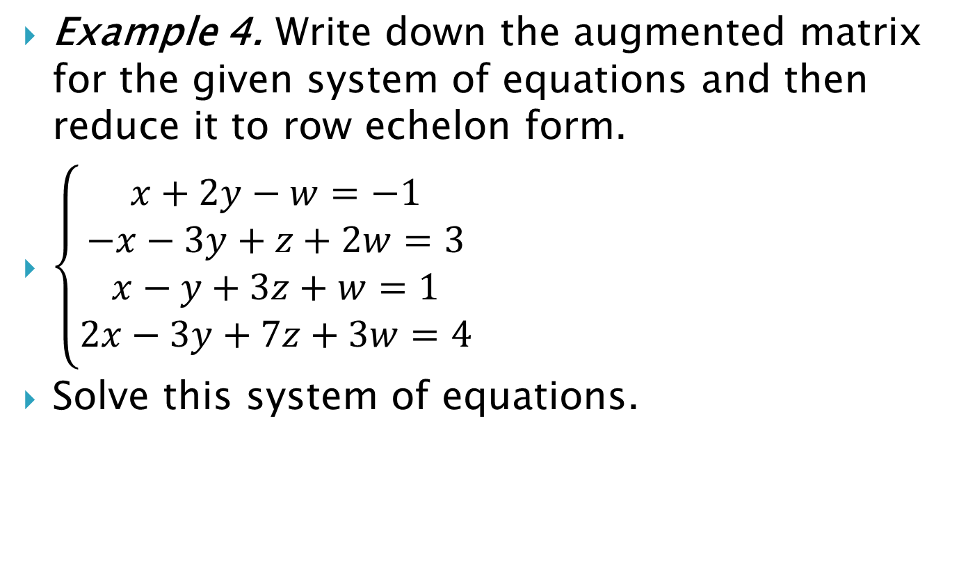
Example 4. Write down the augmented matrix for the given system of equations and then reduce it to row echelon form.
$\left\{\begin{aligned}x+2y−w=−1 \\ −x−3y+z+2w=3 \\ x−y+3z+w=1 \\ 2x−3y+7z+3w=4\end{aligned}\right.$
Solve this system of equations.

Slide 6
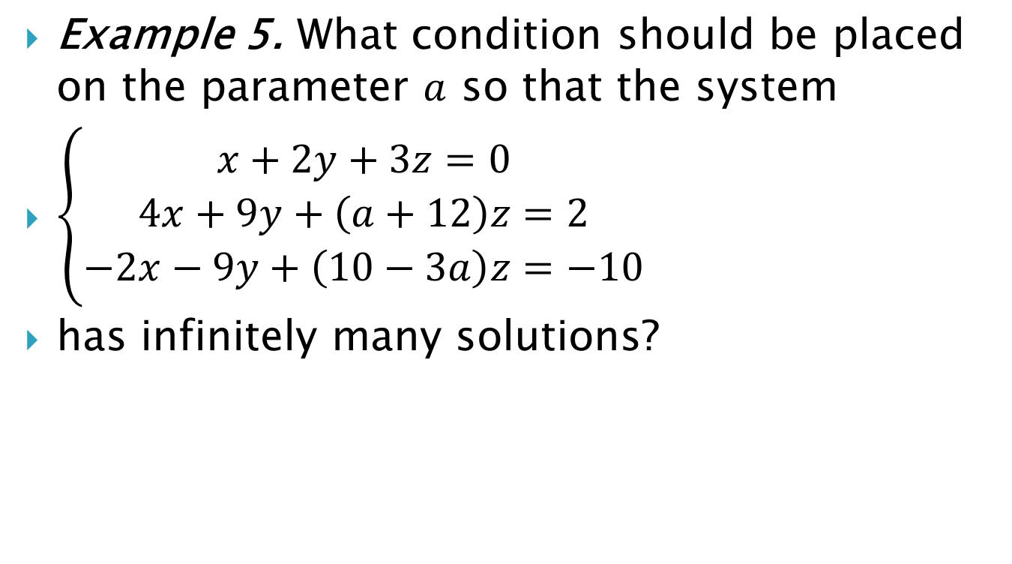
Example 5. What condition should be placed on the parameter $a$ so that the system
$\left\{\begin{aligned}x+2y+3z=0 \\ 4x+9y+\left(a+12\right)z=2 \\ −2x−9y+\left(10−3a\right)z=−10\end{aligned}\right.$
has infinitely many solutions?

Slide 7
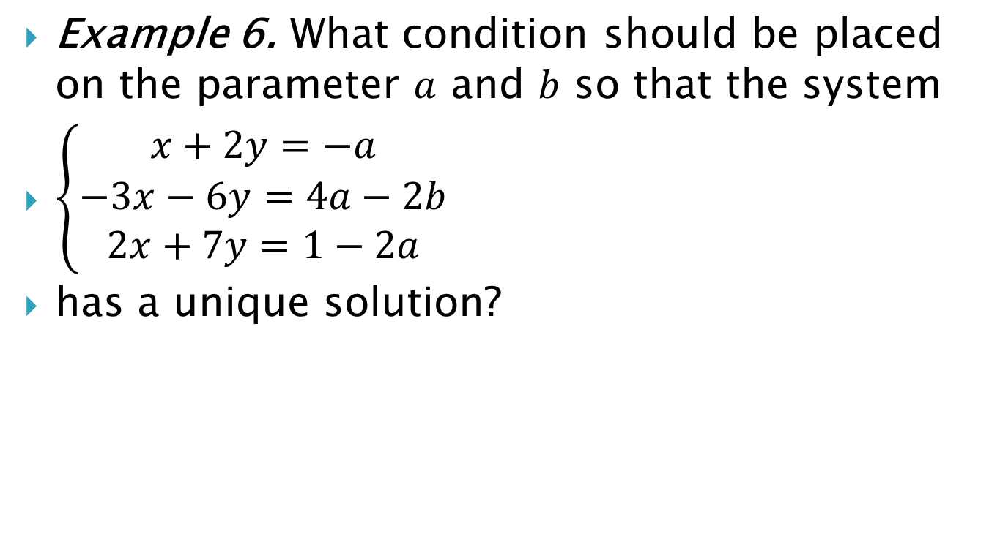
Example 6. What condition should be placed on the parameter $a$ and $b$ so that the system
$\left\{\begin{aligned}x+2y=−a \\ −3x−6y=4a−2b \\ 2x+7y=1−2a\end{aligned}\right.$
has a unique solution?

